Slide 1

SVMs and SGD
Applied Machine Learning Derek Hoiem
Dall-E

Slide 2
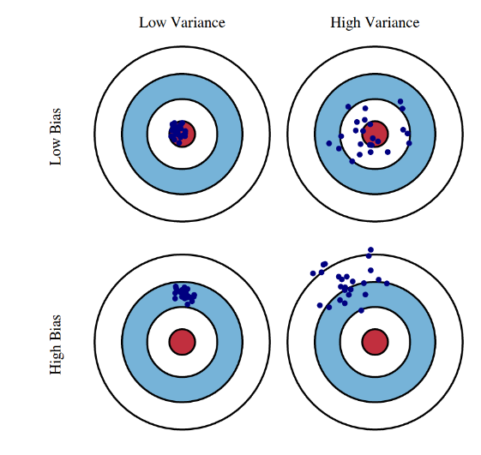
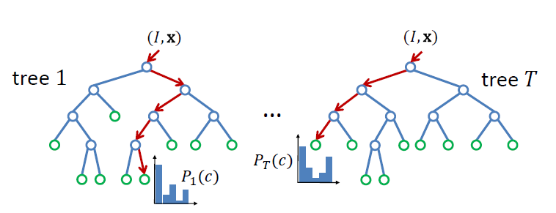
Previously, we learned…
Ensembles improve accuracy by reducing bias and/or variance
Boosted trees and random forests are powerful and widely applicable ensemble methods

Slide 3
Support Vector Machines (SVMs)
Developed in the 1990’s by Vapnik and colleagues at Bell Labs based on statistical learning theory
One of the most popular learning techniques until deep learning resurgence
What is interesting about SVMs
Generalization properties, including achieving a margin and structural risk minimization
Extension to non-linear classifier via kernels
Dual form that shows how linear classifiers can be seen as a weighted average of training examples
Optimization via stochastic gradient descent, also used for neural networks

Slide 4
This lecture
Linear SVM
Kernels and Non-Linear SVM
SVM Optimization with Stochastic Gradient Descent

Slide 5
What is the best linear classifier?
Logistic regression
Maximize expected likelihood of label given data
Every example contributes to loss
SVM
Make all examples at least minimally confident
Base decision on a minimal set of examples
x
x
x
x
x
x
o
x
x
o
o
o
o
x2
x1

Slide 6
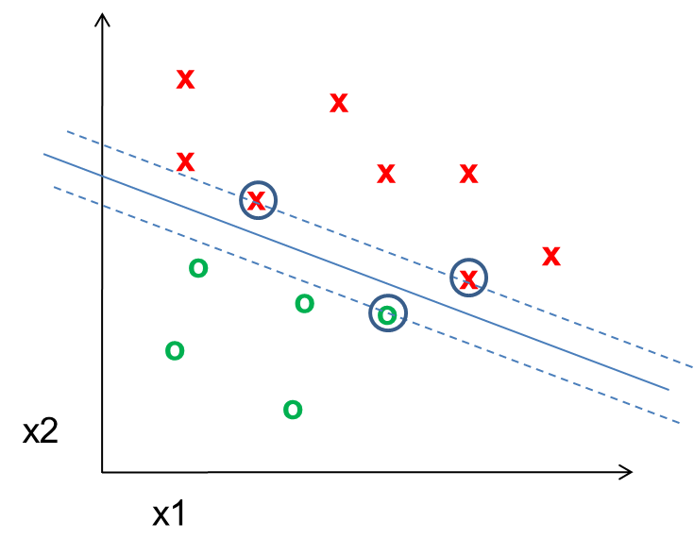
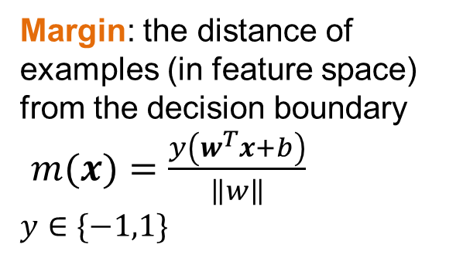
SVM Terminology
Support Vector: an example that lies on the margin (circled points)
Margin: the distance of examples (in feature space) from the decision boundary
$m(x)=\frac{y\left(w^{T}x+b\right)}{\left\|w\right\|}$
$y∈\{−1,1\}$

Slide 7
SVMs minimize $w^{T}w$ while preserving a margin of 1
Optimized SVM Model
Optimized Linear Logistic Regression Model
x
x
x
x
x
x
x
x
x
x
x
x
o
x
o
x
x
x
o
x
o
x
o
x
x
o
x
x
x
x
x
x
x
x
x
o
x
x
o
x
o
o
o
o
w^{T}x+b=0
o
o
x2
o
x2
o
w^{T}x+b=0
x1
x1
Minimizes the sum of logistic error on all samples, so boundary should be further from dense regions
Decision boundary depends only on “support vectors” (circled)
Notes:
5 min

Slide 8
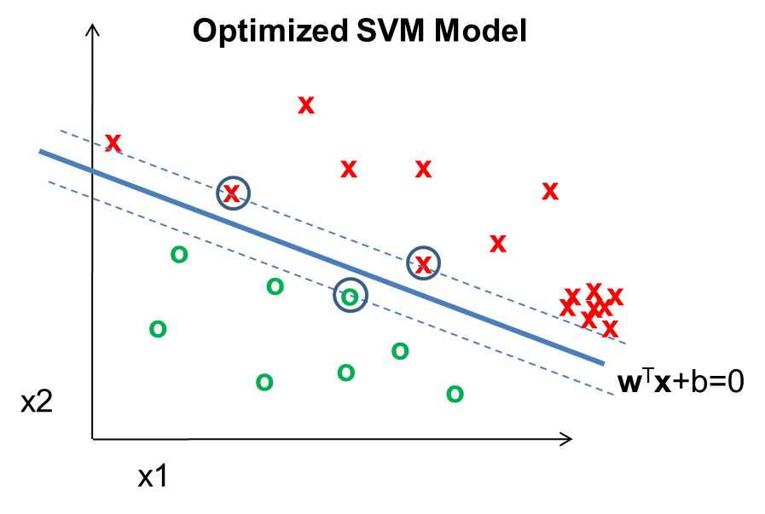
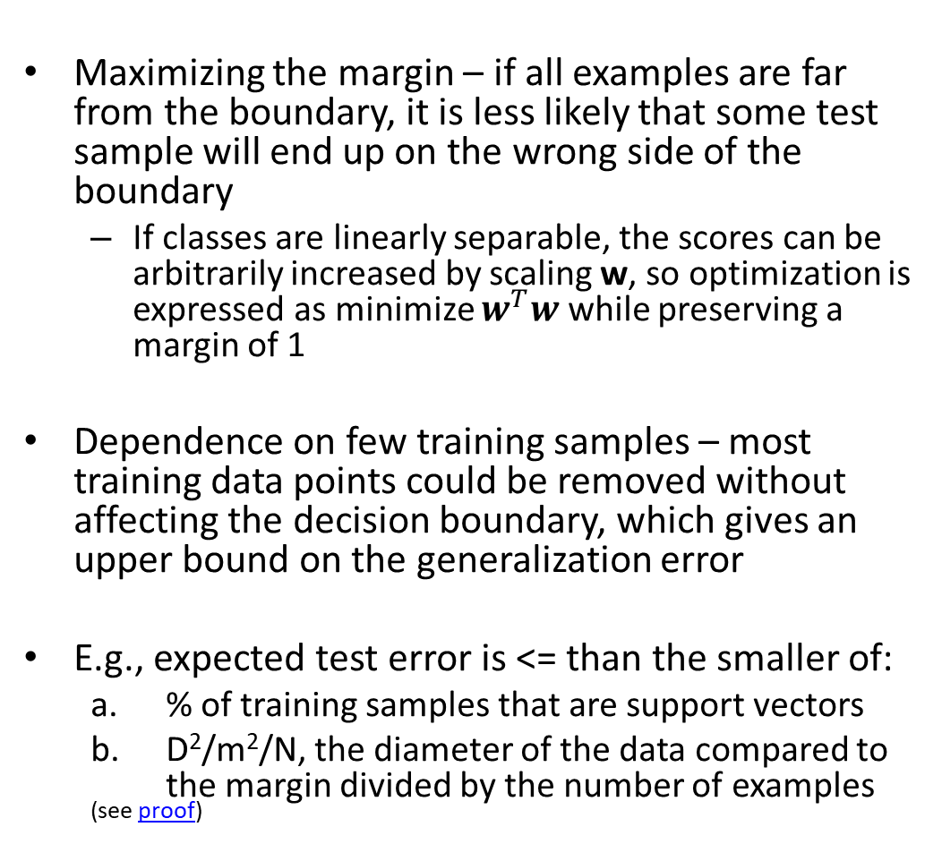
Why SVMs achieve good generalization
Maximizing the margin – if all examples are far from the boundary, it is less likely that some test sample will end up on the wrong side of the boundary
If classes are linearly separable, the scores can be arbitrarily increased by scaling w, so optimization is expressed as minimize $w^{T}w$ while preserving a margin of 1
Dependence on few training samples – most training data points could be removed without affecting the decision boundary, which gives an upper bound on the generalization error
E.g., expected test error is <= than the smaller of:
% of training samples that are support vectors
D²/m²/N, the diameter of the data compared to the margin divided by the number of examples
^{(see proof)}

Slide 9
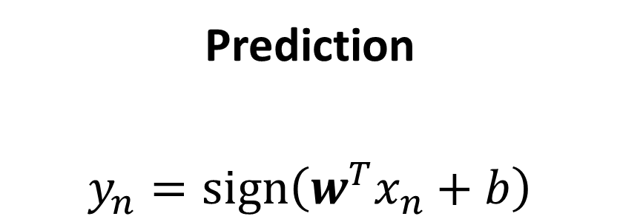
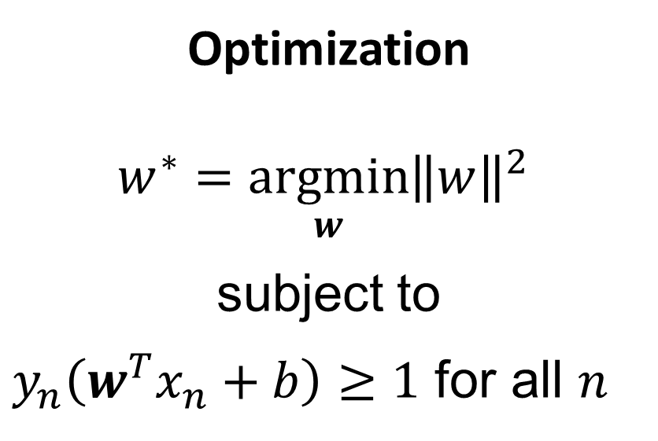
SVM in Linearly Separable Case
Prediction
$$y_{n}=sign\left(w^{T}x_{n}+b\right)$$
Optimization
$$w^{∗}=\underset{w}{argmin}{{\left\|w\right\|}^{2}}$$
subject to
$y_{n}\left(w^{T}x_{n}+b\right)≥1$ for all $n$
Here, $y∈\{−1,1\}$ which is a common convention that simplifies notation for binary classifiers

Slide 10
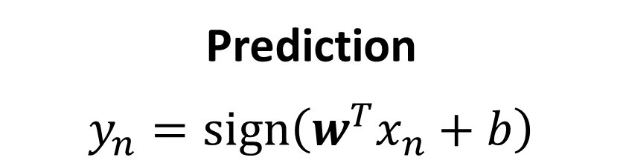
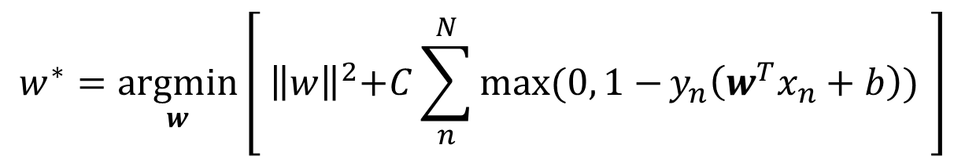
SVM in Non-Linearly Separable Case
Prediction
$$y_{n}=sign\left(w^{T}x_{n}+b\right)$$
Optimization
Known as “hinge loss”
Penalty is paid if margin is less than 1
$$w^{∗}=\underset{w}{argmin}\left[{ \left\|w\right\|}^{2}+C\sum_{n}^{N}{\max{(0, 1−}}y_{n}\left(w^{T}x_{n}+b\right)) \right]$$
Here, $y∈\{−1,1\}$ which is a common convention that simplifies notation for binary classifiers

Slide 11
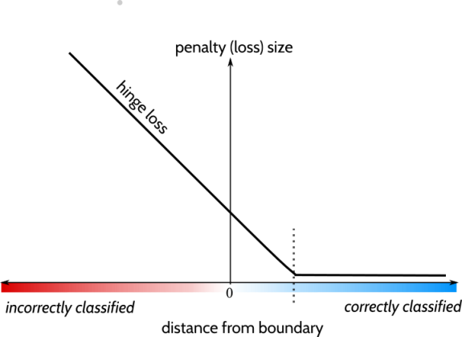
Fig source

Slide 12
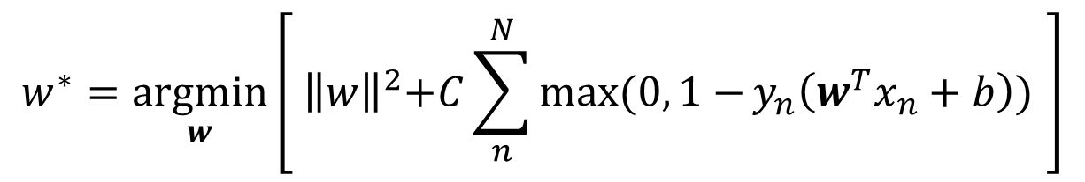
Sometimes non-linear optimization is written in terms of “slack variables”
$$w^{∗}=\underset{w}{argmin}\left[{ \left\|w\right\|}^{2}+C\sum_{n}^{N}{\max{(0, 1−}}y_{n}\left(w^{T}x_{n}+b\right)) \right]$$
is equivalent to
slack variables
Pay slack penalty

Slide 13
Slide credit: Zisserman [link]

Slide 14
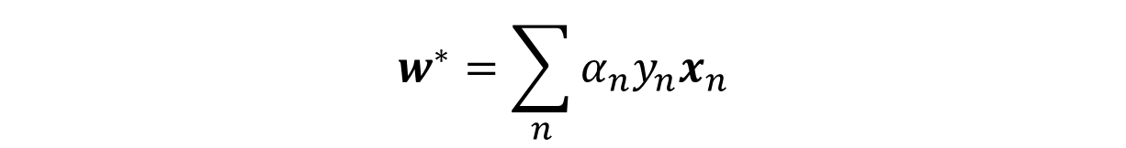
Representer theorem
Optimal weights for many L2-regularized classification and regression functions can be expressed as a weighted combination of training examples
$$w^{∗}=\sum_{n}{α_{n}y_{n}x_{n}}$$
$$α_{n}{≥0, y}_{n}∈\{−1,1\}$$
Conditions apply, e.g. function must be regularized in a Reproducing Kernel Hilbert Space (details)
Does not apply to L1 weight regularization because that can’t be expressed as a dot product of weights

Slide 15
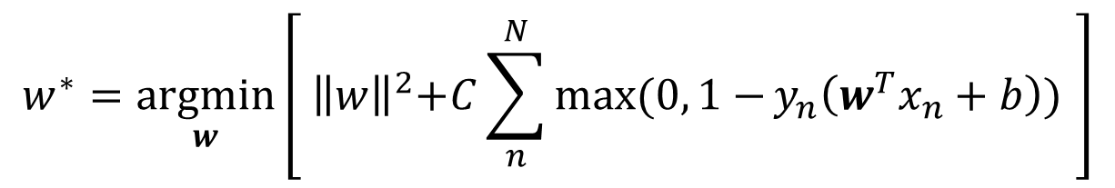
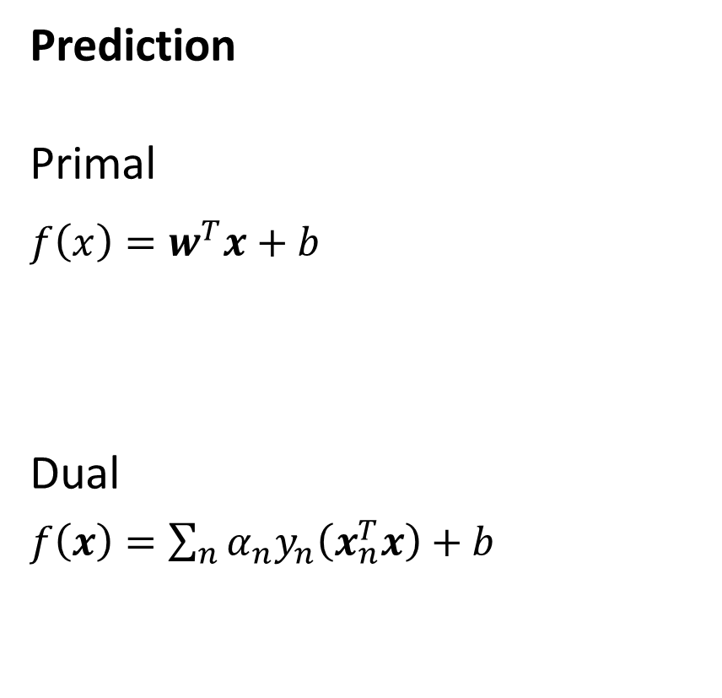
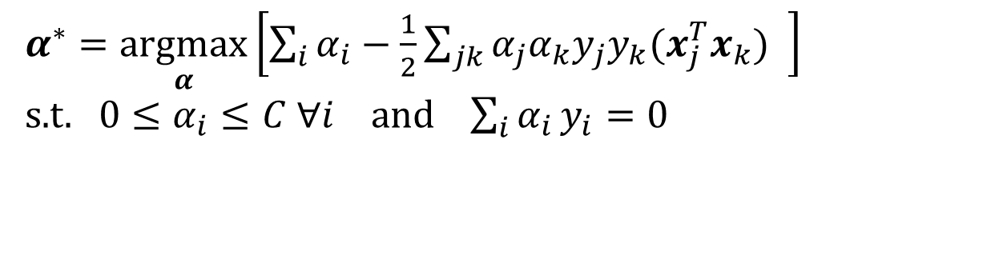
Primal vs. Dual Formulations of SVM
Prediction
Primal
$f\left(x\right)=w^{T}x+b$
Dual
$f\left(x\right)=\sum_{n}{{α_{n}y}_{n}\left(x_{n}^{T}x\right)+b}$
Training Objective
$$w^{∗}=\underset{w}{argmin}\left[{ \left\|w\right\|}^{2}+C\sum_{n}^{N}{\max{(0, 1−}}y_{n}\left(w^{T}x_{n}+b\right)) \right]$$
$α^{∗}=\underset{α}{argmax}\left[\sum_{i}{α_{i}}−\frac{1}{2}\sum_{jk}{α_{j}α_{k}y_{j}y_{k}(x_{j}^{T}x_{k})} \right]$
s.t.$0≤α_{i}≤C ∀i$ and $\sum_{i}{α_{i}}y_{i}=0$
Primal: parameter for each feature
Dual: parameter for each training example

Slide 16
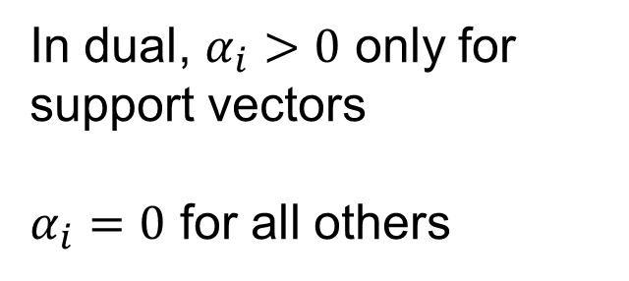
For SVM, $α$ is sparse (most values are zero)
In dual, $α_{i}>0$ only for support vectors
$α_{i}=0$ for all others
Slide credit: Zisserman [link]

Slide 17
But what if the decision boundary is not even close to linear?
Slide credit: Zisserman [link]

Slide 18
Slide credit: Zisserman [link]

Slide 19
Slide credit: Zisserman [link]

Slide 20
Slide credit: Zisserman [link]

Slide 21
Slide credit: Zisserman [link]

Slide 22
Slide credit: Zisserman [link]

Slide 23
Slide credit: Zisserman [link]

Slide 24
Slide credit: Zisserman [link]

Slide 25
Slide credit: Zisserman [link]

Slide 26
Slide credit: Zisserman [link]

Slide 27
Decreasing C gives a wider soft margin
SVM with RBF Kernel Shown
Fig credit: Zisserman [link]

Slide 28
Decreasing sigma makes it more like nearest neighbor
SVM with RBF Kernel Shown
Fig credit: Zisserman [link]

Slide 29
Slide credit: Zisserman [link]

Slide 30
Stretch break
If you were to remove a support vector from the training set, would the decision boundary change?
After break
Application example
Pegasos – SGD optimization
x
x
x
x
x
x
o
x
x
o
o
o
o
x2
x1

Slide 31
Example application of SVM: Dalal-Triggs 2005
Detection by scanning window
Resize image to multiple scales and extract overlapping windows
Classify each window as positive or negative
Very highly cited (40,000+) paper, mainly for HOG
One of the best pedestrian detectors for several years
https://lear.inrialpes.fr/people/triggs/pubs/Dalal-cvpr05.pdf

Slide 32
Example application of SVM: Dalal-Triggs 2005
Very highly cited (40,000+) paper, mainly for HOG
One of the best pedestrian detectors for several years

Slide 33
Example application of SVM: Dalal-Triggs 2005

Slide 34
Using SVMs
Good broadly applicable classifier
Strong foundation in statistical learning theory
Works well with many weak features
Requires parameter tuning for C
Non-linear SVM requires defining a kernel, and slower optimization/prediction
RBF: related to neural networks, nearest neighbor (requires additional tuning)
Chi-squared, histogram intersection: good for histograms (but slower, esp. chi-squared)
Can learn a kernel function
Negatives
Feature learning is not part of the framework (vs trees and neural nets)
Slow training (especially for kernels) – until Pegasos!

Slide 35
Pegasos: Primal Estimated sub-GrAdient SOlver for SVM (2011)
SVM problem that we want to solve
(Minimize weights square + sum of hinge losses on all samples)
Problem in terms of one sample
Gradient in terms of one sample
- Direction to move to improve solution
https://home.ttic.edu/~nati/Publications/PegasosMPB.pdf

Slide 36
Gradient Descent Visualization
Figure source

Slide 37
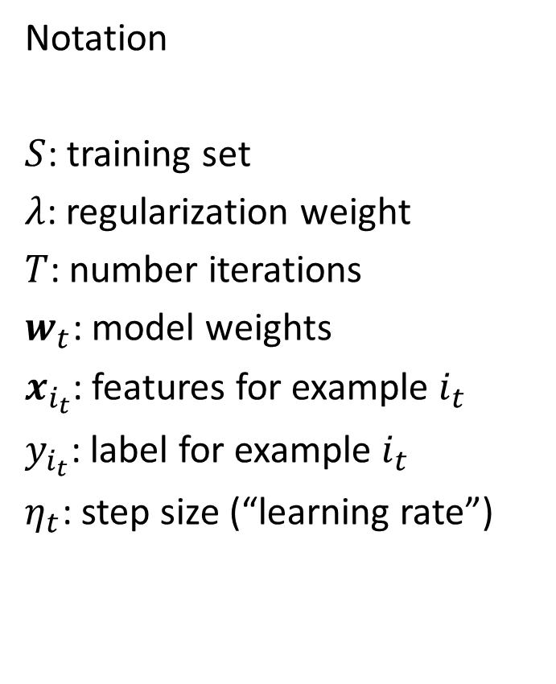
Pegasos algorithm: Stochastic Gradient Descent (SGD)
Notation
$S$: training set
$λ$: regularization weight
$T$: number iterations
$w_{t}$: model weights
$x_{i_{t}}$: features for example $i_{t}$
$y_{i_{t}}$: label for example $i_{t}$
$η_{t}$: step size (“learning rate”)

Slide 38

Pegasos with mini-batch
Calculating gradient based on multiple examples reduces variance of gradient estimate
$k$: batch size
$m$: number of training samples
$A_{t}$: batch of examples
$A_{t}^{+}$: examples within margin
$S$: training set
$λ$: regularization weight
$T$: number iterations
$w_{t}$: model weights
$x_{i}$: features for example $i$
$y_{i}$: label for example $i$
$η_{t}$: step size (“learning rate”)

Slide 39
SGD applies to many losses
z is the score for y=1
SVM (hinge loss)
Logistic regression / sigmoid loss
Hinge L1 regression
Margin loss between scores of most likely and correct label
Variant of a logistic loss

Slide 40
SGD is fast compared to other optimization approaches
SDCA = stochastic dual coordinate descent, another form of sub-gradient optimization that chooses learning rate dynamically

Slide 41
Experiments with Linear SVM
Training time and test error

Slide 42
Experiments using Gaussian kernel SVM (see paper for kernelized Pegasos algorithm)

Slide 43
Effect of mini-batch size

Slide 44
Effect of sampling procedure: randomly ordered epochs is best
Sampling with replacement
Use different random order for each “epoch”
Use same order for each epoch
Epoch: one run through the training set

Slide 45
Learning rate comparison
Zhang uses fixed learning rate
Plots show error over iterations for several rates

Slide 46
Pegasos: take-ways and surprising facts
SGD is very simple and effective optimization algorithm – step toward better solution based on a small sample of training data
Not very sensitive to mini-batch size (but larger batches can be much faster with parallel processing)
The same learning schedule is effective across several problems
A larger training set makes it faster to obtain the same test performance

Slide 47
Next week
Neural networks
Multi-layer perceptrons (MLP)
Deep networks

